Slide 1

Simulation Project -
Team Tetrahedron
Simulation Project - Team D
Milestone #4 – Data Analysis
Milestone #4 –
Data Analysis
Image source: https://cdn.ottopix.de/wp-content/uploads/2019/04/Magdeburg-Panorama-%C3%BCber-der-Hubbr%C3%BCcke.jpg

Slide 2
Agenda
01
03
Simulation Project - Team D
Milestone #4 – Data Analysis
Data Analysis
Difficulties faced
Input data used and output values calculated.
An overview of the difficulties encountered
02
04
Quality of data
Assumptions
An overview of the accuracy and validity of the data.
A brief about the assumptions made.

Slide 3
Data Analysis
Simulation Project - Team D
Milestone #4 – Data Analysis
01
Collecting the data and cleaning it
01
Estimating the underlying distributions function and testing the hypothesis for the inferences.
02
Plotting histogram and estimating the type of distribution
03
Validating the analysis by QQ plot and Chi square test

Slide 4
Input Data
Simulation Project - Team D
Milestone #4 – Data Analysis
01
Data from City of Magdeburg for Pedestrians, bicyclists
02
Data collected by last year group for the inter arrival time distribution function of vehicles.
03
Data collected by our group for traffic light phases

Slide 5



Softwares used:
Simulation Project - Team D
Milestone #4 – Data Analysis
01
Python, Excel
02
Libraries used:
SciPy, Matplotlib, NumPy, Pandas

Slide 6

Collecting and cleaning the data
Simulation Project - Team D
Milestone #4 – Data Analysis
01
The data is in the form of excel sheet.
data = pd.read_excel(….)
data.sort_values(ascending= True)
02
Histogram plotting
sns.distplot(data, hist = true, density = 1, bins = k)
03
Generate qq plot and get the statistics for best fit distribution.
For all distribution types [st.expon, st.lognorm, st.norm]
1. Get the best fit parameters (params = distribution.fit())
2. Generate the Quantiles ( distribution.ppf(data, params))
3. Generate qq plot against raw data(qqplot(data, distribution))
4. Get the statistics of the best fit line
if lognormal, normal (mean, standard deviation)
if exponential(lambda, minimum value)

Slide 7
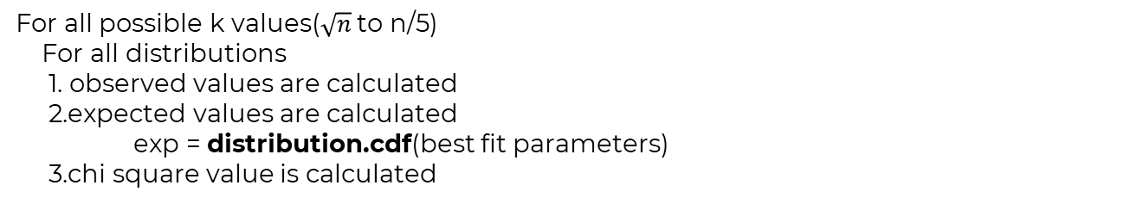
Chi square test
Simulation Project - Team D
Milestone #4 – Data Analysis
01
Chi square test is called Goodness-of- fit test
02
chisquare = (np.power(Expected - observed), 2)) / Expected
calculated = np.sum(chisquare)

Slide 8
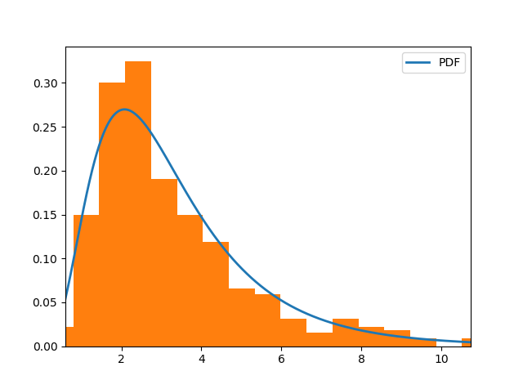
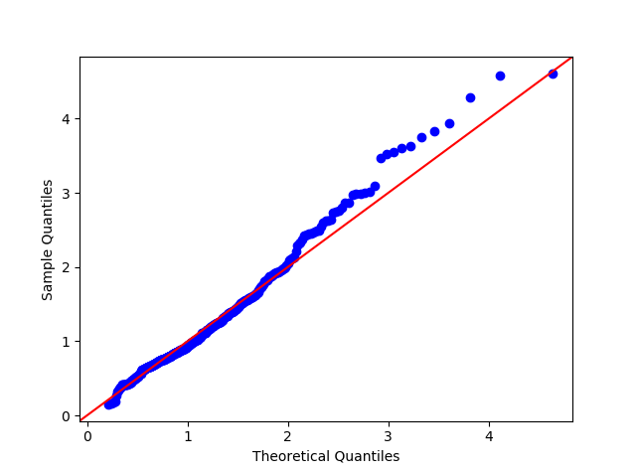
Findings of Erich-Weinert Str
Simulation Project - Team D
Milestone #4 – Data Analysis
Histogram
QQ plot
Distribution: Lognormal
Statistics : Mean = 1.161 , Standard deviation=0.533

Slide 9
Comparison of parameters for Erich – Weinert- Str
Simulation Project - Team D
Milestone #4 – Data Analysis
Distributions: | Exponential | Lognormal | Normal
Chi- square for k =31 bins | 209.96 | 38.797 | 1008.30
Sum of Squared error of quantiles against 45 degree line | 495.77 | 44.06 | 458.17
Is Chi- Square calculated less than tabulated
Distribution

Slide 10
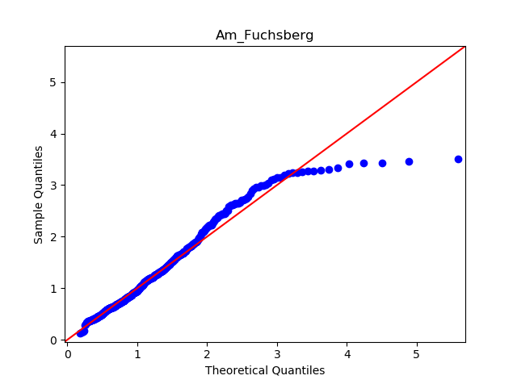
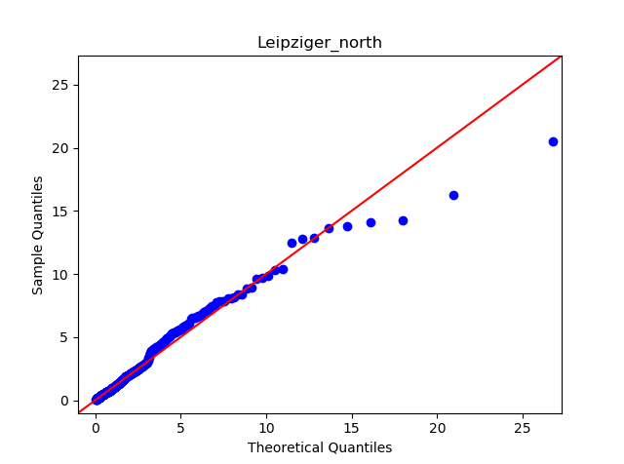
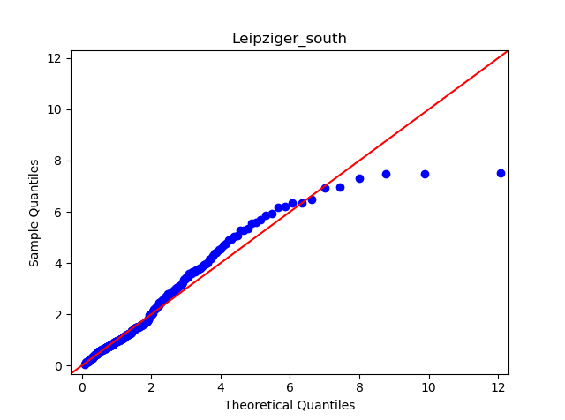
Findings of Am Fuchsberg str:
Simulation Project - Team D
Milestone #3 - Conceptual Model
Distribution : Log normal
Mean = 1.267
standard deviation= 0.593
Findings of Leipziger str North:
Distribution : Log normal
Mean = 1.511
standard deviation= 1.112
Findings of Leipziger str South:
Distribution : Log normal
Mean =0.662
standard deviation= 0.871

Slide 11
Pedestrians and bicyclists
Simulation Project - Team D
Milestone #4 – Data Analysis
For Am Fuchsberg to Erich- Weinert - Str
Distribution: Uniform distribution
Min value = 10 sec
Max value = 20sec
Trams:
Leipziger str south Leipziger str north
Distribution :Truncated normal
Min value = 8 minutes, Max value = 12 minutes,
Standard deviation = 2 minute, mean = 10minutes

Slide 12
Traffic light phases
Simulation Project - Team D
Milestone #4 – Data Analysis
Timing | P1 | P2 | P3 | P4 | P5 | P6 | P7 | P8
P1 = uniform_discr(29, 30)
P2,P4,P6,P8 = 4
P5 = uniform_discr(39, 41)
P3 = uniform_discr(51, 62)
P7 = uniform_discr(65, 70)

Slide 13
Simulation Project - Team D
Milestone #4 – Data Analysis
Data Quality
An overview on ways to assess Data Quality

Slide 14
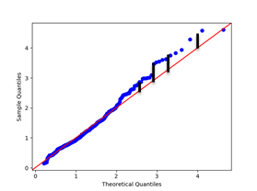
Sum of squared errors
Simulation Project - Team D
Milestone #4 – Data Analysis
01
Sum of squared errors(SSE) gives the information about how far the expected data lies from the actual point.
02
Sum of squared error = 44.06

Slide 15
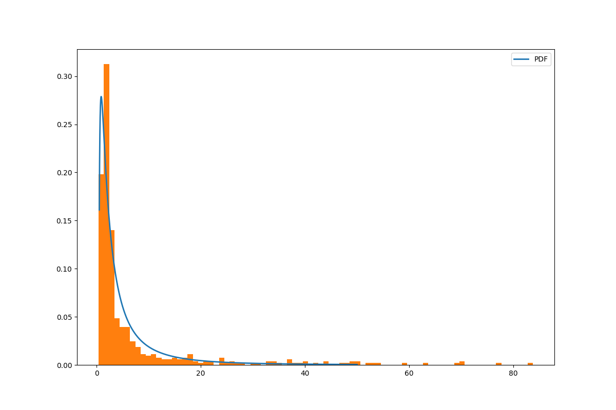
Trade- offs
Simulation Project - Team D
Milestone #4 – Data Analysis
Trade off between Variance due to outliers and estimation of distribution function.
Variance 145.705501
Data is censored there by reducing variance in order to get good estimate for the distribution function.

Slide 16
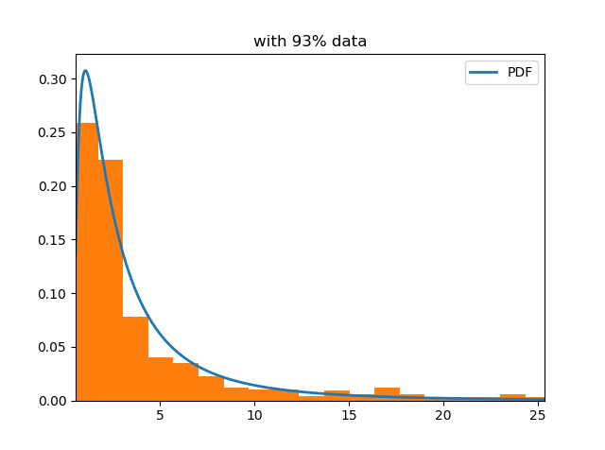
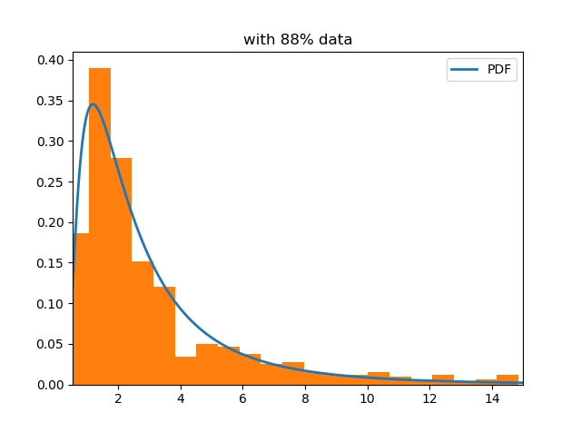
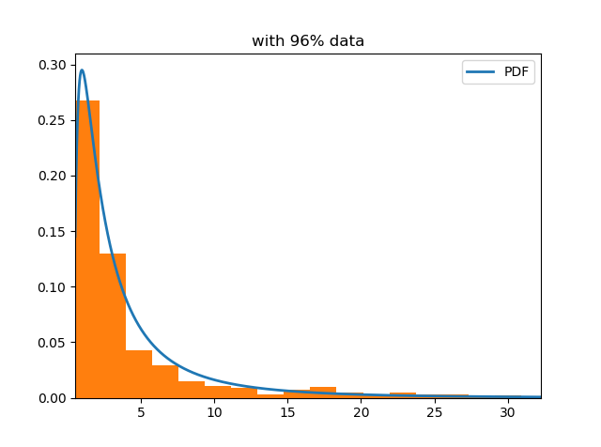
Simulation Project - Team D
Milestone #4 – Data Analysis
Pre-data censor
Post- data censor
Variance: 145.705501
rejected null hypothesis with 95% C.I for all distribution types
Variance = 7.719009
Log Normal :Failed to reject null hypothesis with 95% confidence interval at k = 34
Variance: 26.079071
Lognormal: failed to reject null hypothesis with 95% confidence level at k=83
Variance: 48.390222
Failed to reject null hypothesis for log normal distribution at k = 91

Slide 17
Assumptions:
Simulation Project - Team D
Milestone #4 – Data Analysis
01
We assume all the motor vehicles are of the same type.
04
We assume there are no major changes in the behavior of cars and pedestrians between different years
02
We assume all pedestrians and cyclists behave in the same way
05
We tried to fit the conventional distribution functions.
03
Pedestrians go in only one direction.

Slide 18
So far
Simulation Project - Team D
Milestone #4 – Data Analysis
Tasks completed and costs incurred so far

Slide 19
Tasks completed so far
✓
✓
✓
✓
Simulation Project - Team D
Milestone #4 – Data Analysis
Completed analyzing the data from previous years
Completed analyzing the data from the city of Magdeburg
Incorporated required elements in simulation model
Update work as issues in GitHub.

Slide 20
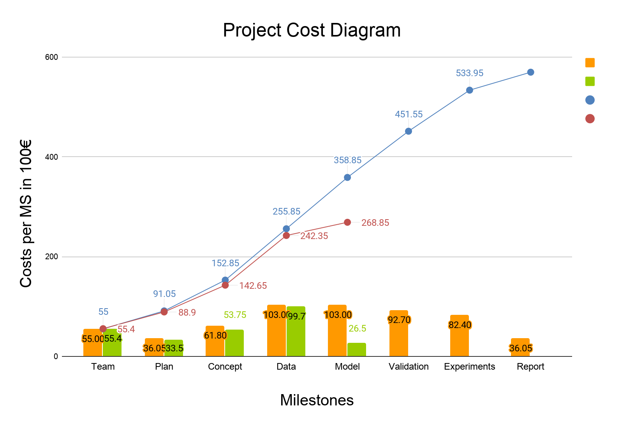
Cost comparison
Simulation Project - Team D
Milestone #4 – Data Analysis
Estimated cost
Actual cost
Cumulative estimate
Cumulative actual

Slide 21
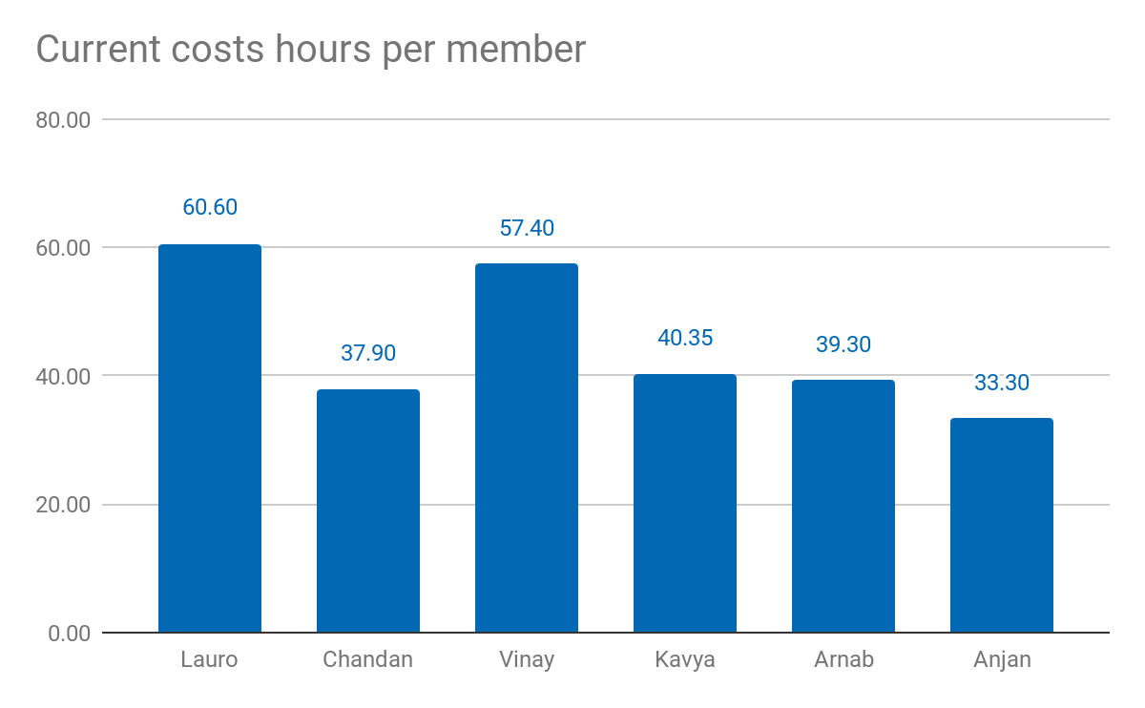
Current costs as % of total cost: 44.48%
Current costs: 26.885,00 €
Simulation Project - Team D
Milestone #4 – Data Analysis

Slide 22
Lessons learned
01
02
02
03
Simulation Project - Team D
Milestone #4 – Data Analysis
Guess work is error prone
Do the homework as well
Update time chart the same day

Slide 23
05
Thank you!
Simulation Project - Team D
Milestone #4 – Data Analysis
Questions?

